Slide 1
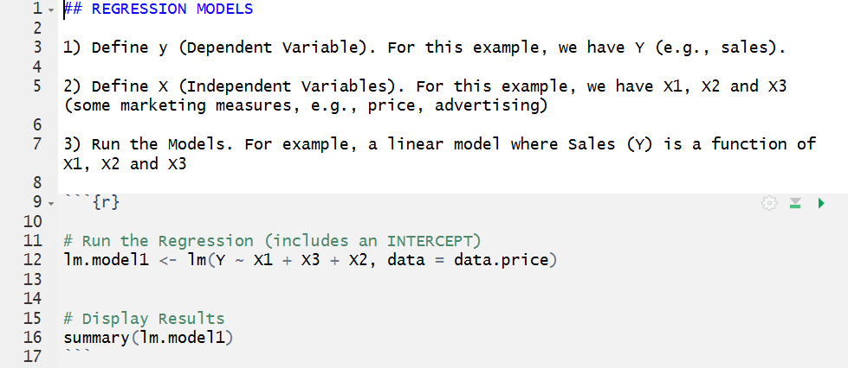
Your name for the model output. I use lm (for linear model) and a number. But again, your choice.
lm is the linear model package, it will run your regression
You need to tell the model the name of your dataset (in my example “data.price”)
The names of all the independent variables you want to use “connected” by a “+” sign
Name of your model to get the output with estimates and t-stats
The name of the dependent variables you want to use followed by a “~” sign

